Slide 1
Intelligent Robot Arm
Pham Quang Minh
Nguyen Quoc Anh
Hoang Le Tri Cuong
Notes:
Hello prof, welcome to our project presentation. Our team consists of 3 members, Pham Quang Minh, Nguyen Quoc Anh, and me, Hoang Le Tri Cuong.

Slide 2
Content
Problem Definition & Proposed Solution
Implementation & Challenges
Actuators & Kinematics
Computer: Raspberry Pi 4
Motors & Motor Driver
Camera & Calibration
Object Detection
Coordinate Mapping
Controls
Fine-tuning
Evaluation
Coordinate Mapping Evaluation
Robot Operation Evaluation
Notes:
Here is the summary of our presentation. We will first go through the problem definition and proposed solution.
Then we will dive deeper into the implementation and challenges.
After that, we will evaluate our results, and at last, we will talk about our future plans for the project.

Slide 3
Problem & Solution
Recent advancements in Intelligent Robot
=> Ability to assist people with disabilities
AIM: Develop a robotic arm to grab targeted objects and deliver to user.
STEPS:
Identify object using camera and object detection model
Convert image to operational coordinates
Execute a series of step to grab and deliver objects to user
Notes:
First, let us start of with our problem definition and proposed solution.
Recent advancements in intelligent robots hold the potential to significantly enhance assistive technology for seniors and individuals with disabilities.
For instance, individuals with conditions like Cerebral Palsy, characterized by a spectrum of motor impairments,
could greatly benefit from intelligent robot arms that can detect objects in real-time and deliver to user.
As such, that is also our aim for the project.
We used a camera and a light-weight object detection model to identify the object. Then,
we converted the object image to the operational coordinates.
At last, we created an algorithm to plan and execute a series of steps to reach the object.

Slide 4
Problem & Solution
CONSTRAINTS:
2-finger end-effector => cylindrical target only
1 camera, no depth sensor => manually provide depth information
Fixed delivery coordinates
Notes:
However, due to certain resource and time constraints, we simplified our goals a bit.
• As our robotic arm uses two-finger end-effector, there are not a lot of objects that it can
grab. As such, something cylindrical is preferred, in our case, a small water bottle.
• We also utilize only one camera as our sole sensor of the environment. Therefore, we are
not able to ascertain the depth of the targeted object. To simplify this, we fix the object at a
constant distance from the horizontal line where the camera is at.
• We have also fixed the destination of the user, where the robotic arm will deliver the object.

Slide 5
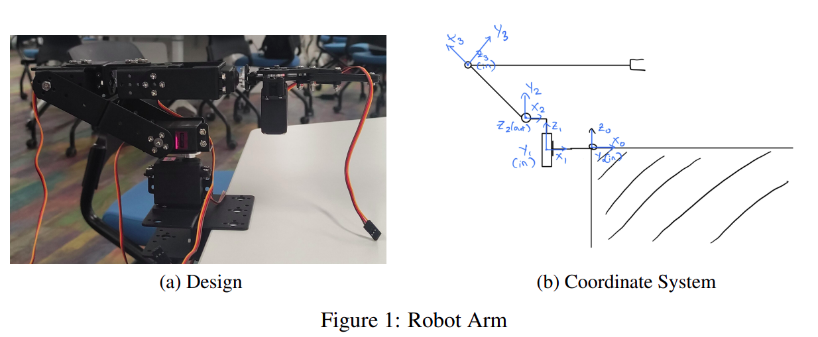
2. Implementations and Challenges
2.1. Actuators and Kinematics

Slide 6
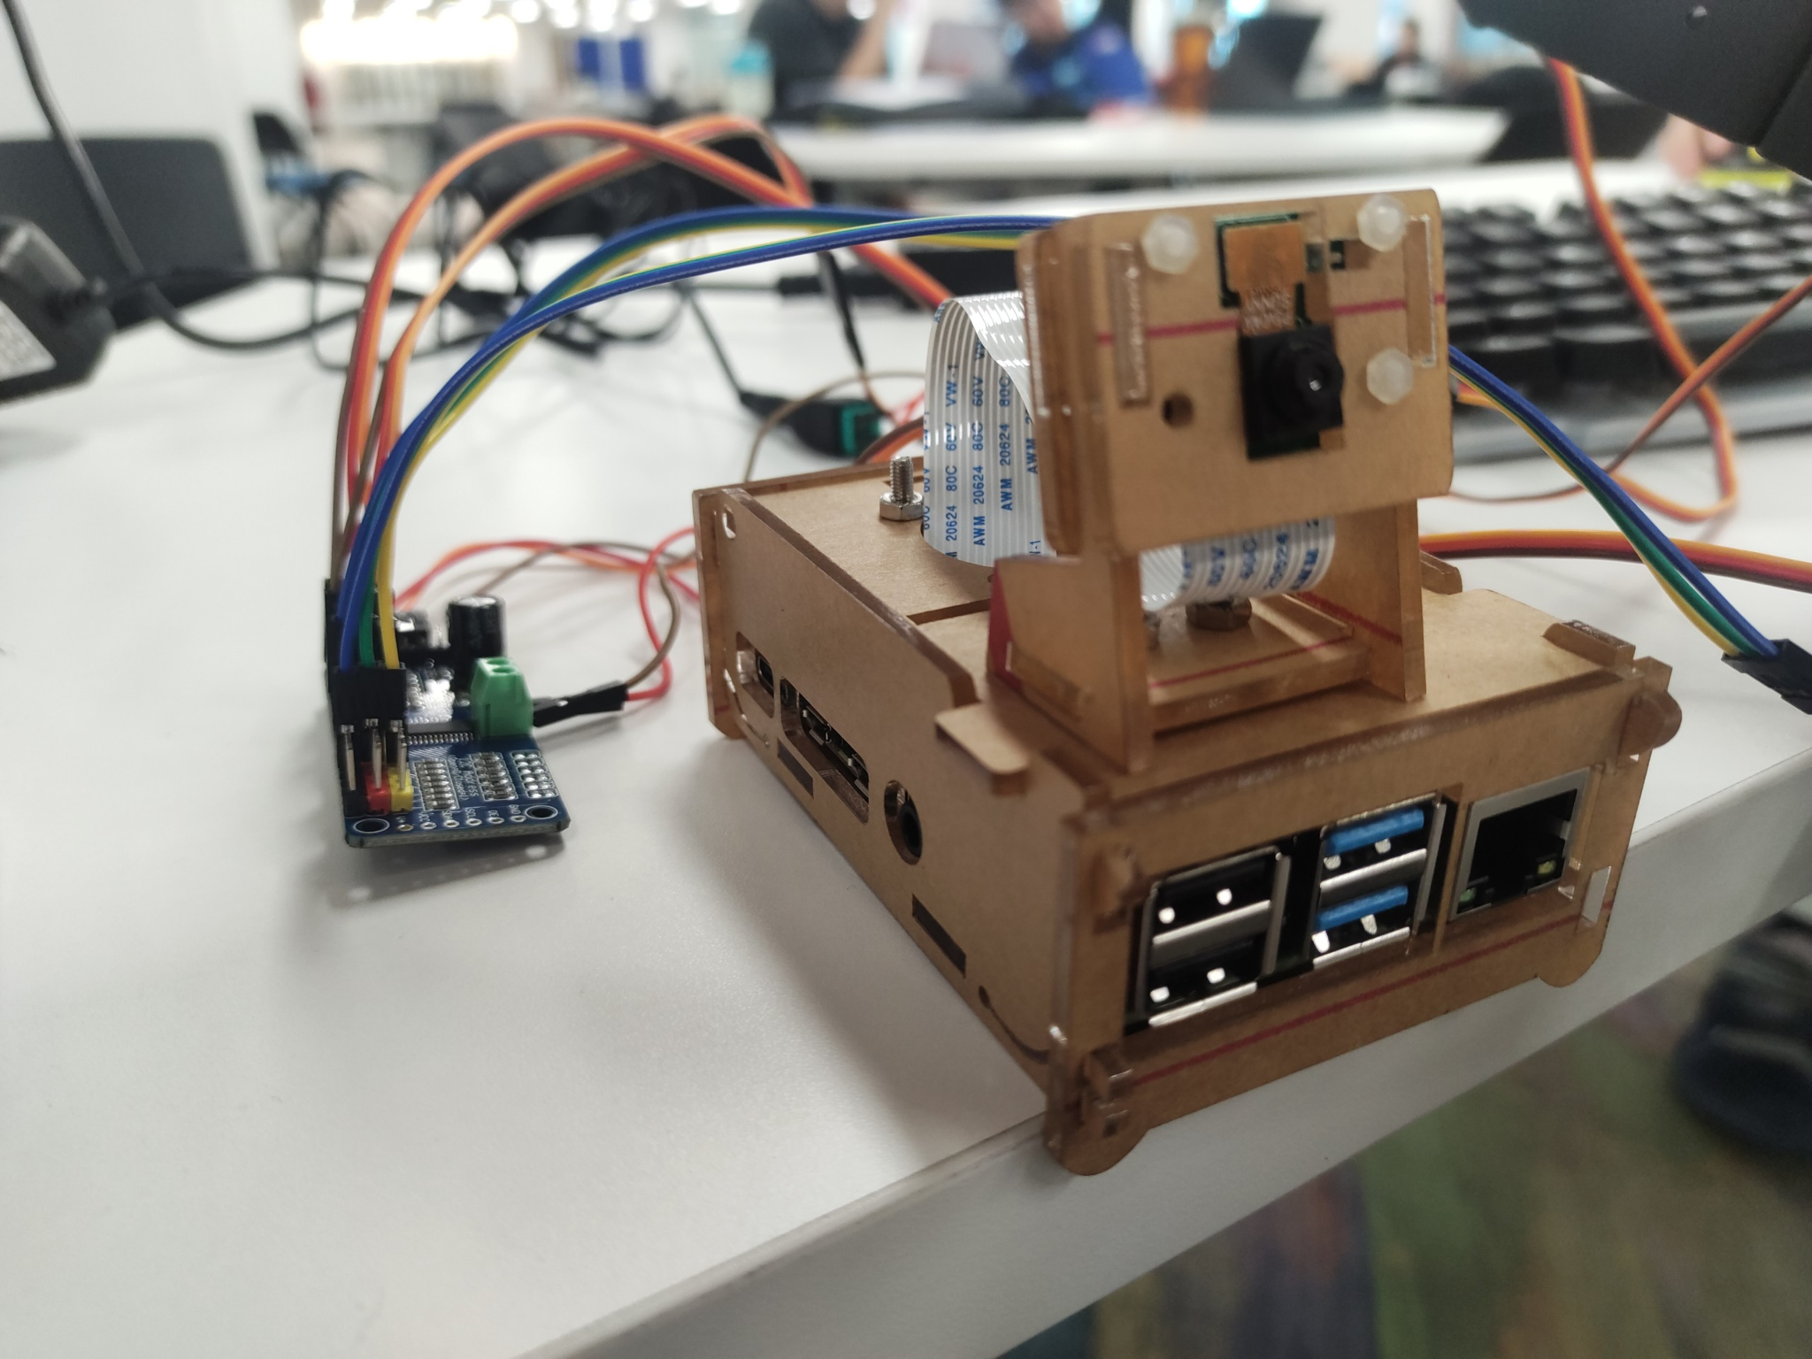
2.2. Computer: Raspberry Pi 4
Affordable
Powerful compared to size
General-purpose input/output pins
Popular & Highly supported
Suitable for robotics project

Slide 7
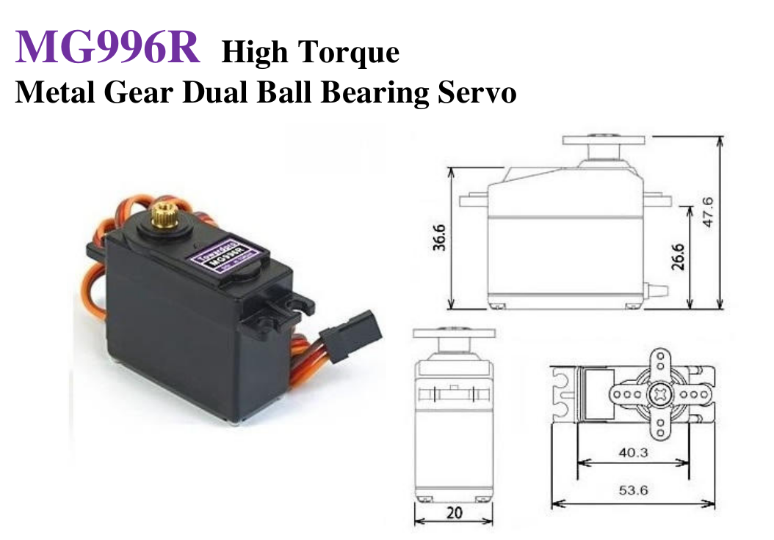
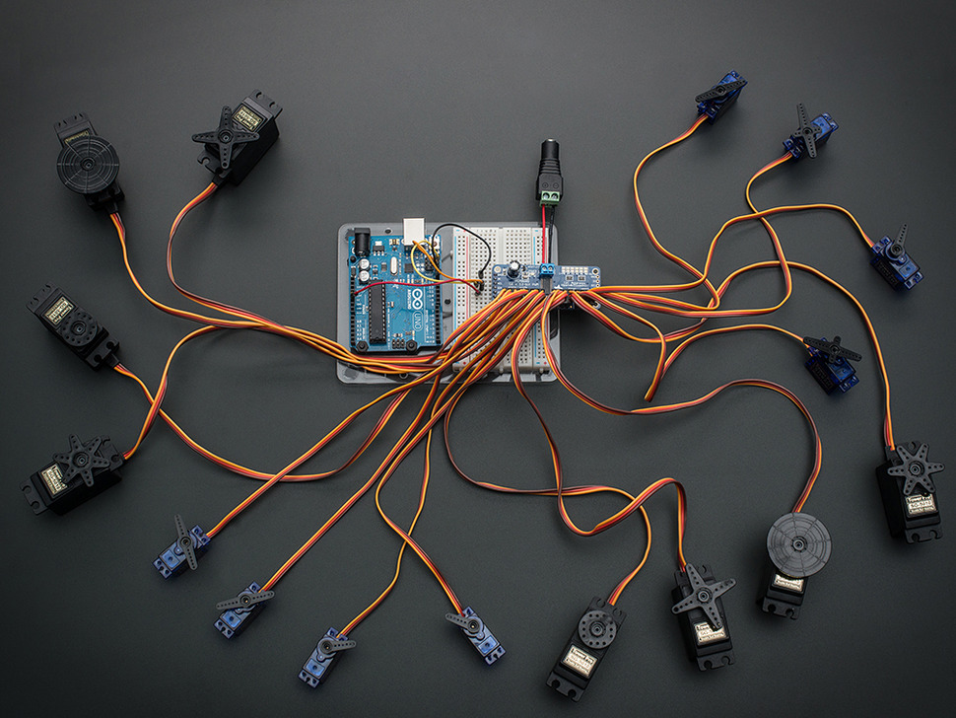
2.3. Motor and Motor Driver

Slide 8
2.4. Camera & Calibration: Camera system
The system uses a 1 camera system to capture the target position
Pros: Simple to set up
Cons: Unable to infer target depth from only 1 source of vision
Target depth information is given to the system to work around this limitation

Slide 9
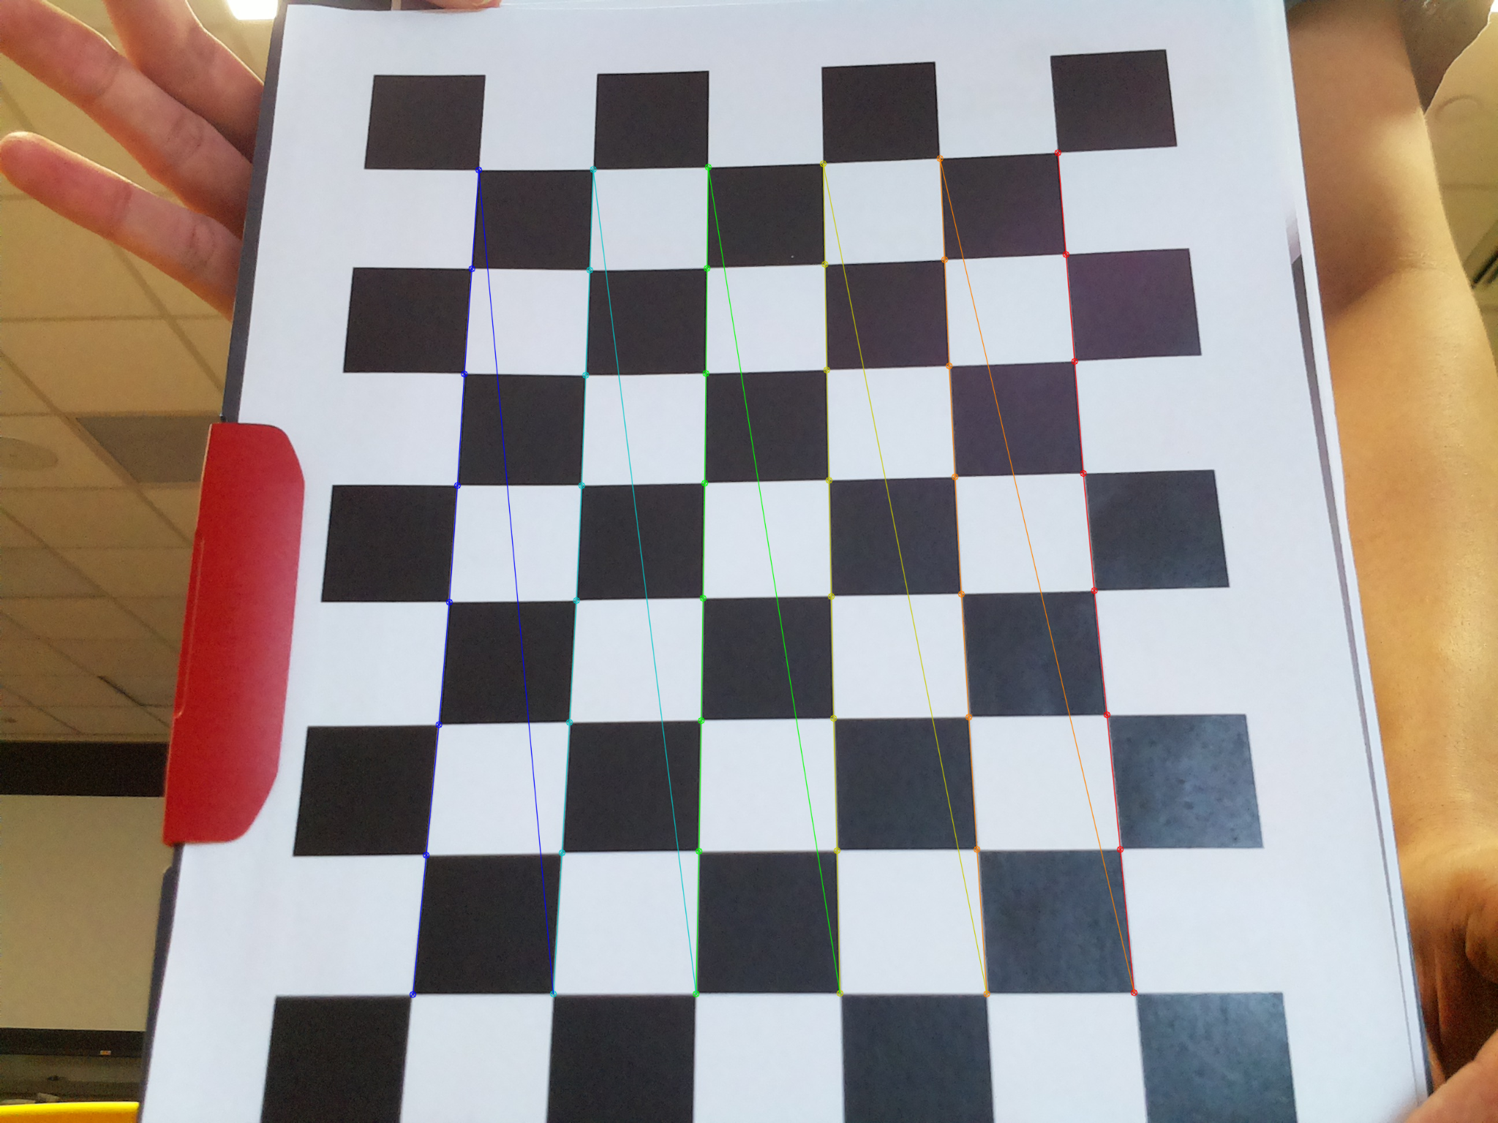
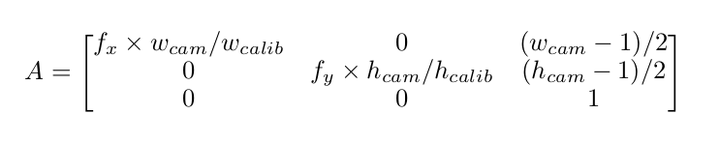
2.4. Camera & Calibration: Intrinsic matrix
Calibration methods: use checkerboard pattern and OpenCV library to get focal lengths
Adjusting the intrinsic matrix to fit the camera resolution of object detection program

Slide 10
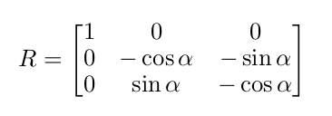
2.4. Camera & Calibration: Extrinsic matrix
Camera is slightly tilted upward at a certain angle
Use theoretical calculation of the rotation matrix and extrinsic matrix returned from calibration step to verify the value of the angle

Slide 11
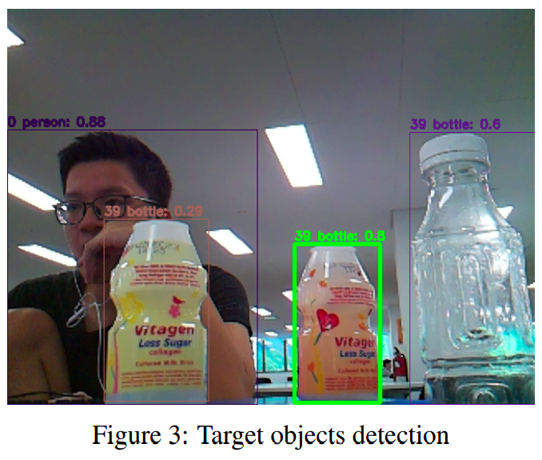
2.5. Object Detection

Slide 12
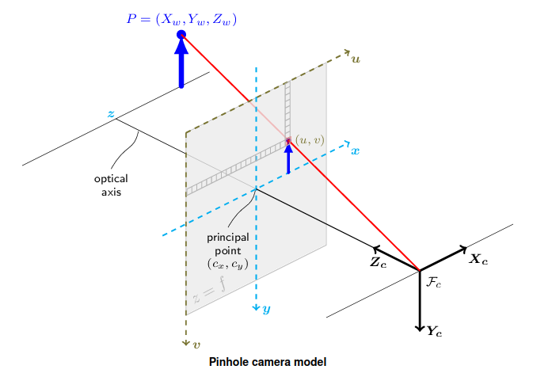
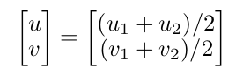
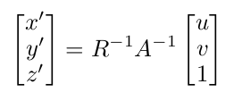
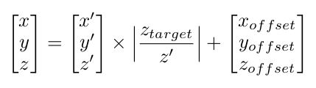
2.6. Coordinate Mapping: Pixel→World
Coordinate of the target in the camera is the center of the bounding box
Calculate the scaled world coordinate from the intrinsic & extrinsic matrices
Use the manually provided depth information to calculate world coords

Slide 13
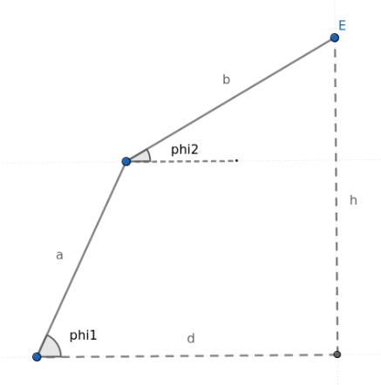
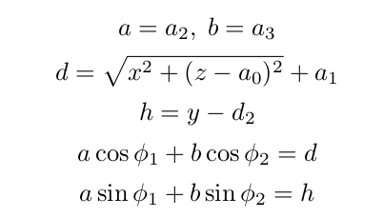
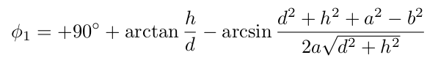
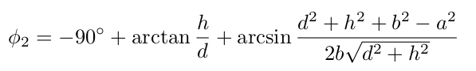
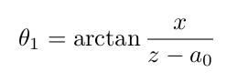
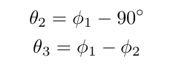
2.6. Coordinate Mapping: World→Operational
Solve the angles by converting to the following system of equations:
Select the solution set with the arms above the ground out of the 2 solutions:
Convert to operational coordinates:

Slide 14
2.7. Controls: Calibration
Pulse-Width Modulation (PWM):
Min: 400 (0 degrees)
Max: 2700 (208 degrees)
Offsets:
Servo 1: +98 degrees
Servo 2: +158 degrees
Servo 3: +180 degrees
Formula:
servo_angle = offset + direction * operational_coordinate
Notes:
Next, we will move onto the controls.
To rotate the motors, we first input them with Pulse-Width Modulation signals.
We calibrated the motors and found the MIN PULSE of 400 and a MAX_PULSE of 2700 to be the safe limits that would provide a rotation of 0 to 208 degrees.
Then, we map the operational coordinates to inputs for the servos.
We found the offsets as shown on the screen.
We then use a formula to convert from operational coordinates to servo input
We also put some limit on how much each servo can rotate, because if the torque is too high when the
servo gets stuck, the servo heats up a lot which can damage itself. servo 2 cannot go below 60◦ and
servo 3 cannot go below 30◦.

Slide 15
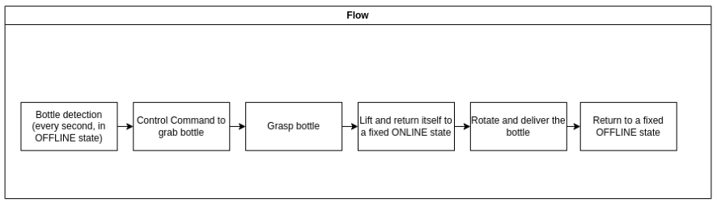
2.7. Controls: Full Flow

Slide 16
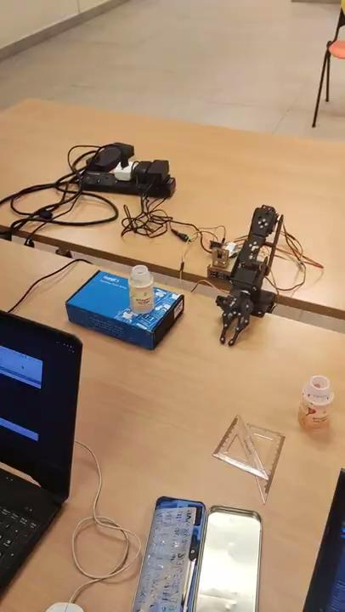
2.7. Controls: Naive Controls
Once detected the object and finished mapping the coordinates, the robot rotate joint 1 to angle itself toward the object
It opens the end-effector, then move joint 2 then 3 to the object
Grasp the object, then move it to the user, before returning to the offline state
Since the movement is in default pretty high speed and move each arm once sequentially, it will hit the object a lot, even with minor error, knocking the bottle out.

Slide 17
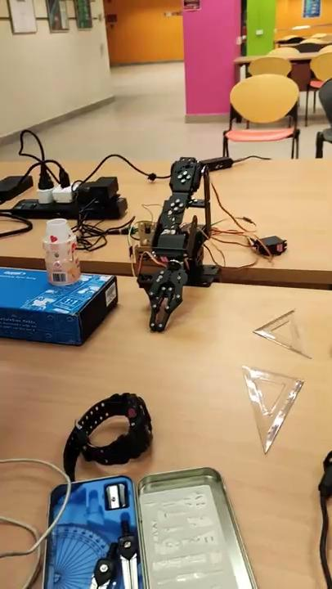
2.7. Controls: Segmented Controls
Divide the angle path for joint 2 and 3 to 10 equal intervals
Reach by alternating between joint 2 and 3 for more delicate movement, sliding the object into the grasp
Thereby also slowing down the reaching movement.
Helps with successful grasping

Slide 18
2.8. Fine-Tuning
Adjusting the length of the arm connected to the claw/endpoint to improve success rate
If length is too small (innermost of the claw), the target will fall over when the arm is reaching out
If the length is too long (tip of the claw), the claw won’t be able to properly grasp without having the target slip just out of reach
Having the arm length ends at a middle point inside the claw ensure that the target is within the claw grasp before picking up the target
Fine-tuned length also reduce the deviation of the calculated angle to the target

Slide 19
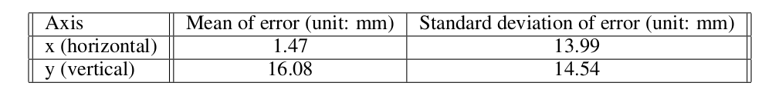
3. Testing & Evaluation
3.1. Coordinate Mapping Evaluation
Measure the accuracy of the world coordinate mapping function from camera input
Target is placed at random coordinations, provide the target depth to system to infer
Result:
Low mean of error in horizontal axis
Mean of error is noticeably higher in vertical axis, but doesn’t make the claw miss the target
Standard deviation of error in both axis is acceptable for operation (errors from measuring tools and processes also make this higher than its true value)
Conclusion: coordinate mapping is sufficiently accurate for the robot to grasp the target

Slide 20
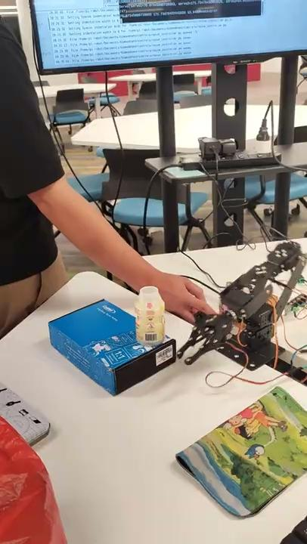
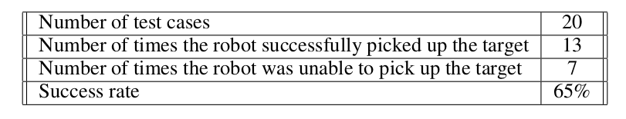
3.2. Robot Operation Evaluation
Robot is tasked to grasp and pick up the target
Target is randomly placed around a certain depth (depth information of the target is provided)
Out of 20 tries, the robot successfully picked up the target 13 times, reaching a success rate of 65%

Slide 21
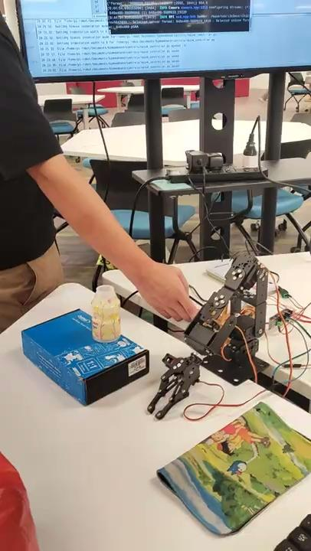
3.2. Robot Operation Evaluation
Cause of failure cases is mostly not due to the claw missing the target
In failure cases, the claw is angled downward which led to the tip of the claw being at the bottom of the target
When grasping the target, the bottle slip upward and launched out of the grasp vertically
It is possible to further fine-tune the grasping location to improve success rate

Slide 22
Conclusion
We’ve successfully developed a robot arm that assist people by bringing stuff with computer vision with reasonable success rate.
For future works, we can improve the system by using grasp-pose estimator, using stereo cameras for depth sensing, and path planning for obstacle avoidance.

